Slide 1

Super Resolution
報告人：洪宗邑、蕭英祐
指導教授：翁世光教授
影片介紹
https://www.youtube.com/watch?v=LH5OBCjm8VA

Slide 2
Outline
Introduction
Interpolation
Linear
Cubic
Lagrange
Result and analysis
EDSR

Slide 3
Introduction
What is super-resolution(SR)?
SR aims to reconstruct a higher resolution image from lower resolution images
It is used when high resolution images is not always available due to sensor’s limitations
We use SR because of high computation time needed for high quality ray tracing images
We can produce a low quality ray tracing image, then use SR procedure to quickly upscale it with details

Slide 4
Introduction
E
E
Reconstruction approach
Use multiple low resolution images
Registration
Recover the image by different math method
Example-based approach
Convolution neural networks architecture in most cases
Supervised learning
SRCNN, SRGAN, ESRGAN
Notes:
Registration:將這多個影像中的對應點映射到原始場景中的實際點，並將資料轉換到同一座標系中，
如圖，他可以有個planar surface的基準的image，那其他的image就按照角度按每個點會對應到哪裡，然後眼睛是在影像中心 Math model:可能做傅立葉轉換、內插

Slide 5
























Mapping two image
Assume there are 4 points that need to be resampled to 8 points.
$$X_{0}$$
$$X_{1}$$
$$X_{2}$$
$$X_{3}$$
$$X_{0}^{′}$$
$$X_{1}^{′}$$
$$X_{2}^{′}$$
$$X_{3}^{′}$$
$$X_{4}^{′}$$
$$X_{5}^{′}$$
$$X_{6}^{′}$$
$$X_{7}^{′}$$
$$X_{0}$$
$$X_{1}$$
$$X_{2}$$
$$X_{3}$$
$$X_{0}^{′}$$
$$X_{1}^{′}$$
$$X_{2}^{′}$$
$$X_{3}^{′}$$
$$X_{4}^{′}$$
$$X_{5}^{′}$$
$$X_{6}^{′}$$
$$X_{7}^{′}$$
Notes:
對應主要用上面
下面是分固定區塊

Slide 6
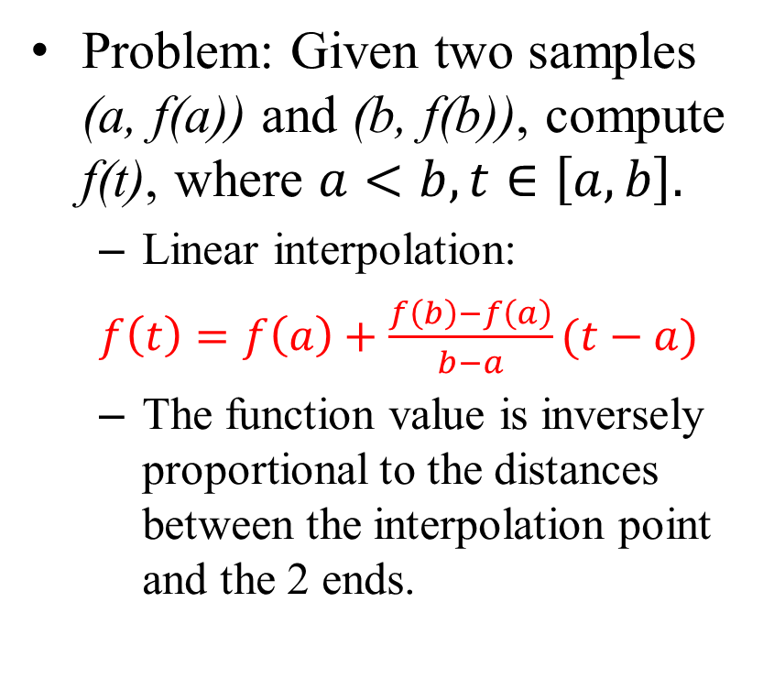
Linear Interpolation
Problem: Given two samples (a, f(a)) and (b, f(b)), compute f(t), where $a<b, t∈\left[a,b\right].$
Linear interpolation:
$f\left(t\right)=f\left(a\right)+\frac{f\left(b\right)−f\left(a\right)}{b−a}(t−a)$
The function value is inversely proportional to the distances between the interpolation point and the 2 ends.
The graph
a
t
b
Notes:
這之前其實還有個nearest neighbor 但是很明顯出來的圖不會平滑

Slide 7
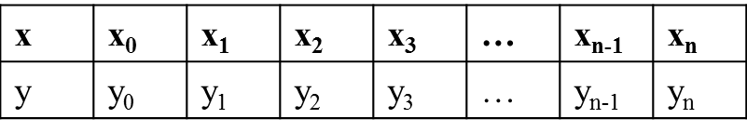
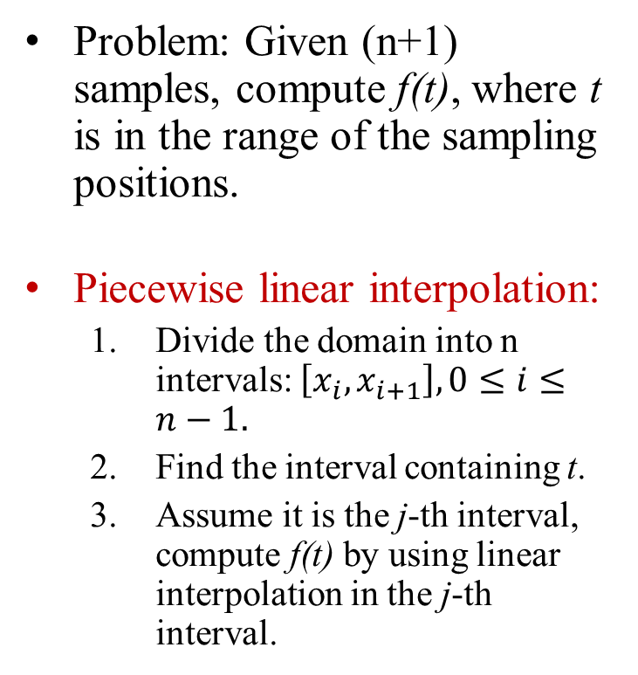
Piecewise Linear Interpolation
Problem: Given (n+1) samples, compute f(t), where t is in the range of the sampling positions.
Piecewise linear interpolation:
Divide the domain into n intervals: $\left[x_{i},x_{i+1}\right],0≤i≤n−1.$
Find the interval containing t.
Assume it is the j-th interval, compute f(t) by using linear interpolation in the j-th interval.
The input data:
The piecewise linear interpolation function s(x) consists of n linear polynomials.
x₀
x_{n}
x_{i}
x_{i+1}

Slide 8
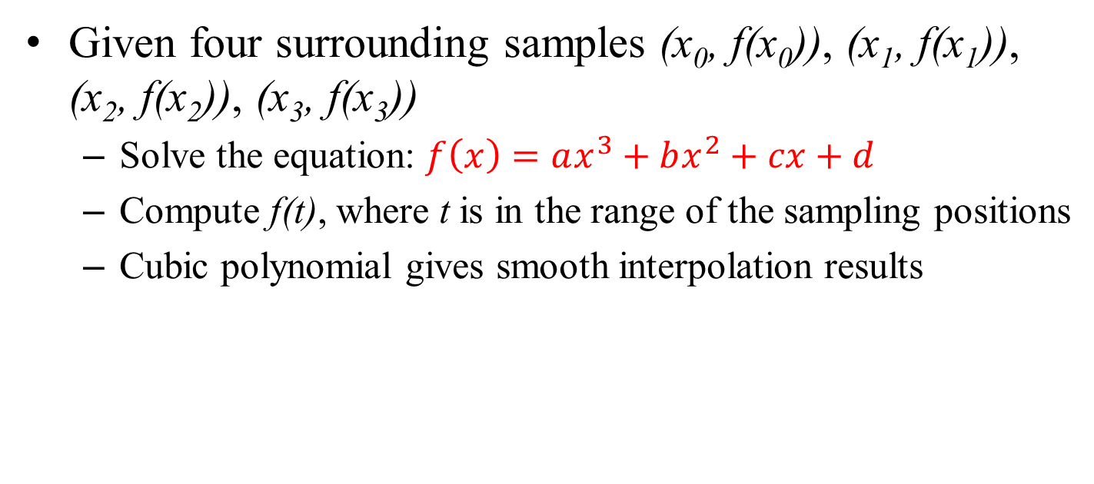




Cubic Interpolation
Given four surrounding samples (x₀, f(x₀)), (x₁, f(x₁)), (x₂, f(x₂)), (x₃, f(x₃))
Solve the equation: $f\left(x\right)=ax^{3}+bx^{2}+cx+d$
Compute f(t), where t is in the range of the sampling positions
Cubic polynomial gives smooth interpolation results
$$x_{0}$$
$$x_{1}$$
t
$$x_{2}$$
$$x_{3}$$
Notes:
那前面可以看到線段之間是獨立的，都不連續，所以我們有了cubic，用三次多項式來擬合會順暢很多

Slide 9
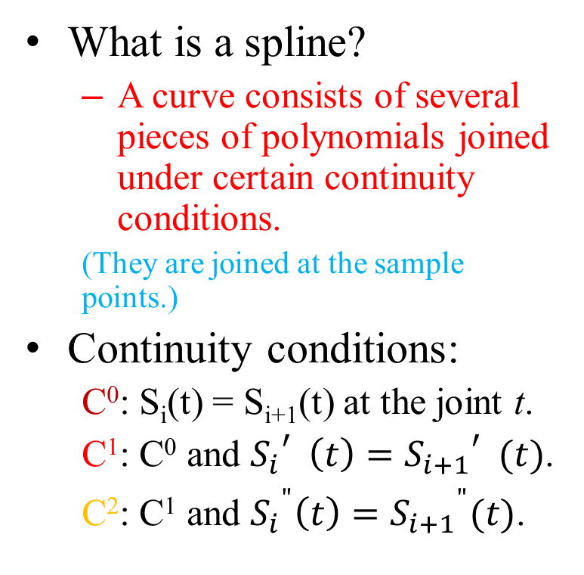
Splines
What is a spline?
A curve consists of several pieces of polynomials joined under certain continuity conditions.
(They are joined at the sample points.)
Continuity conditions:
C⁰: S_{i}(t) = S_{i+1}(t) at the joint t.
C¹: C⁰ and ${S_{i}}_{}^{′}\left(t\right)={S_{i+1}}_{}^{′}(t)$.
C²: C¹ and ${S_{i}}^{"}\left(t\right)={S_{i+1}}^{"}(t)$.
A spline of 3 pieces
S₁(t)
S₀(t)
S₂(t)

Slide 10
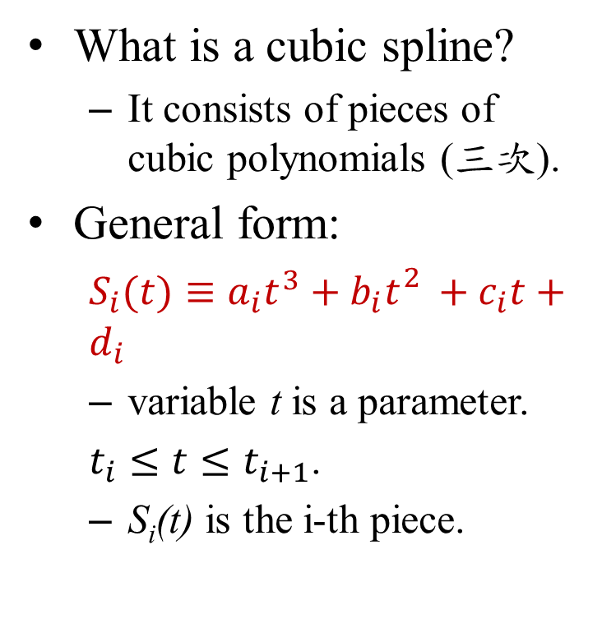
Cubic Splines
What is a cubic spline?
It consists of pieces of cubic polynomials (三次).
General form:
$S_{i}(t)≡a_{i}t^{3}+b_{i}{t_{}^{2}+c}_{i}t+d_{i}$
variable t is a parameter.
$t_{i}≤t≤t_{i+1}$.
S_{i}(t) is the i-th piece.
A spline of 3 pieces.
S₁(t)
S₀(t)
S₂(t)
t₀
t₁
t₂
t₃
Notes:
三次通常效果最好，不過過度複雜也夠平滑

Slide 11
Natural Cubic Splines
Required conditions:
Assume there are n+1 samples {(t_{i}, f_{i})}, 0 ≤ i ≤ n.
There are n pieces of polynomials, S_{i}(t).
C² continuity at the joints t_{i}, 1≤ i ≤ n.
S₀”(t₀) = S_{n}”(t_{n}) = 0.
The input data:
t | t₀ | t₁ | … | t_{n}
f | f₀ | f₁ | … | f_{n}
t₀
t_{n}

Slide 12
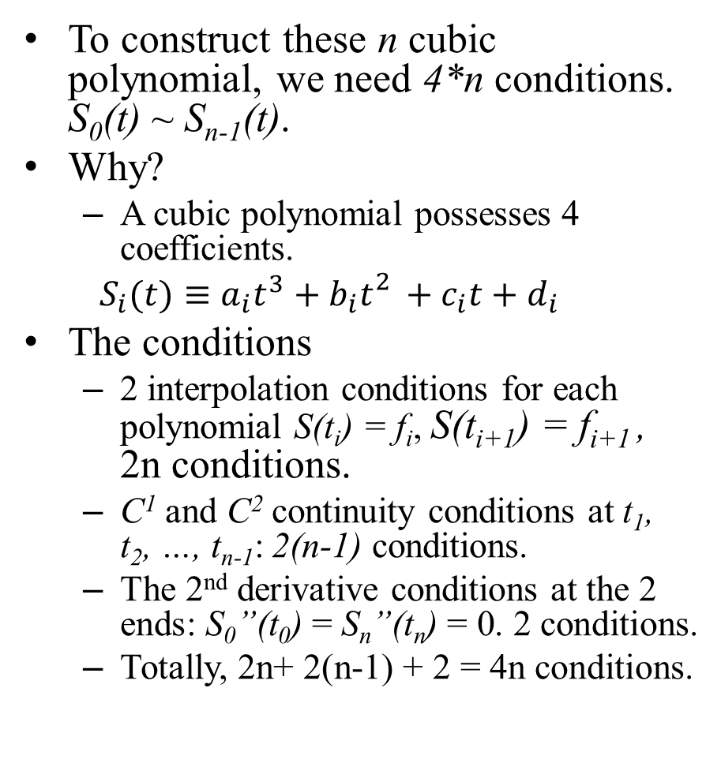
Interpolation Conditions
To construct these n cubic polynomial, we need 4*n conditions. S₀(t) ~ S_{n-1}(t).
Why?
A cubic polynomial possesses 4 coefficients.
$$S_{i}(t)≡a_{i}t^{3}+b_{i}{t_{}^{2}+c}_{i}t+d_{i}$$
The conditions
2 interpolation conditions for each polynomial S(t_{i}) = f_{i}, S(t_{i+1}) = f_{i+1} , 2n conditions.
C¹ and C² continuity conditions at t₁, t₂, …, t_{n-1}: 2(n-1) conditions.
The 2nd derivative conditions at the 2 ends: S₀”(t₀) = S_{n}”(t_{n}) = 0. 2 conditions.
Totally, 2n+ 2(n-1) + 2 = 4n conditions.
A spline of 3 polynomials
S₁(t)
S₀(t)
S₂(t)
t₀
t₁
t₂
t₃
Notes:
(Blabla解釋完) 那通常用cubic spline也是像這張圖一樣取附近四個點 用這三個三次多項式來內插

Slide 13
2D interpolation
Problem: Given the coordinates and function values of the 4 corners of a rectangle (2x2 grid cell), compute the function value f(s, t).
Assume P₀ = (x₀, y₀).
use 16 nearest neighbor points for bicubic interpolation (a 4x4 grid cell)
The Method
Interpolate each column along the Y-axis first, then interpolate each row along the X-axis
The order of which axis interpolate first doesn’t affect the results
P₃, f₃
P₂, f₂
Y
A
(s, t)
B
k
P₀, f₀
h
P₁, f₁
X

Slide 14
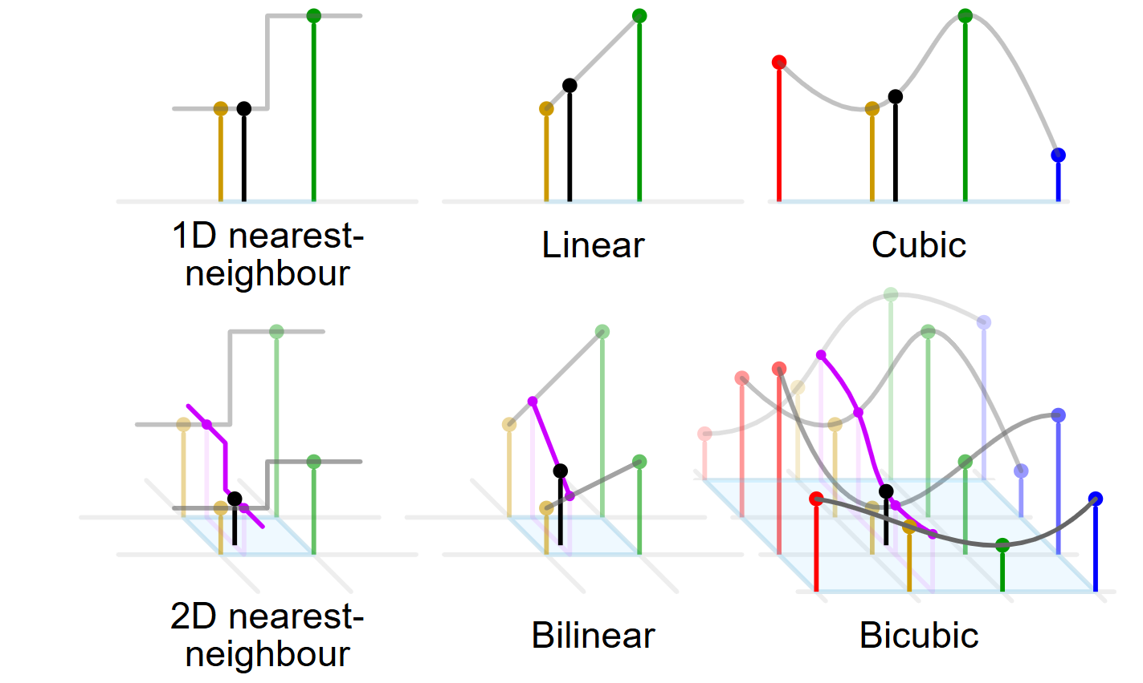
2D interpolation
X
Y
X

Slide 15
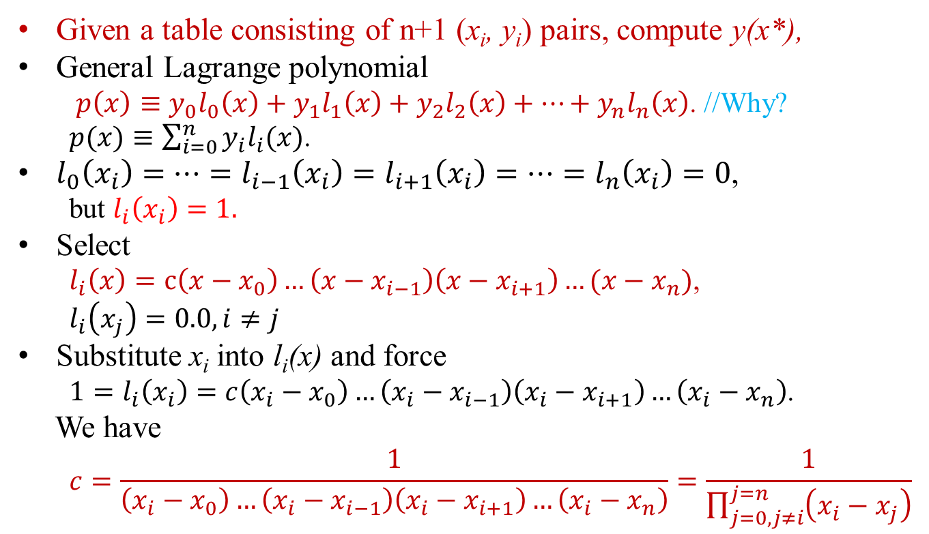
Lagrange interpolation
Given a table consisting of n+1 (x_{i}, y_{i}) pairs, compute y(x*),
General Lagrange polynomial
$p\left(x\right)≡y_{0}l_{0}\left(x\right)+y_{1}l_{1}\left(x\right)+y_{2}l_{2}\left(x\right)+…+y_{n}l_{n}\left(x\right)$. //Why?
$p(x)≡\sum_{i=0}^{n}{y_{i}l_{i}(x)}$.
$l_{0}\left(x_{i}\right)=…=l_{i−1}\left(x_{i}\right)=l_{i+1}\left(x_{i}\right)=…=l_{n}\left(x_{i}\right)=0$,
but $l_{i}\left(x_{i}\right)=1.$
Select
$l_{i}\left(x\right)=c\left(x−x_{0}\right)…\left(x−x_{i−1}\right)\left(x−x_{i+1}\right)…(x−x_{n})$,
$l_{i}\left(x_{j}\right)=0.0, i≠j$
Substitute x_{i} into l_{i}(x) and force
$1=l_{i}\left(x_{i}\right)=c\left(x_{i}−x_{0}\right)…\left(x_{i}−x_{i−1}\right)\left(x_{i}−x_{i+1}\right)…\left(x_{i}−x_{n}\right)$.
We have
$$c=\frac{1}{\left(x_{i}−x_{0}\right)…\left(x_{i}−x_{i−1}\right)\left(x_{i}−x_{i+1}\right)…\left(x_{i}−x_{n}\right)}=\frac{1}{\prod_{j=0,j≠i}^{j=n}{\left(x_{i}−x_{j}\right)}}$$

Slide 16
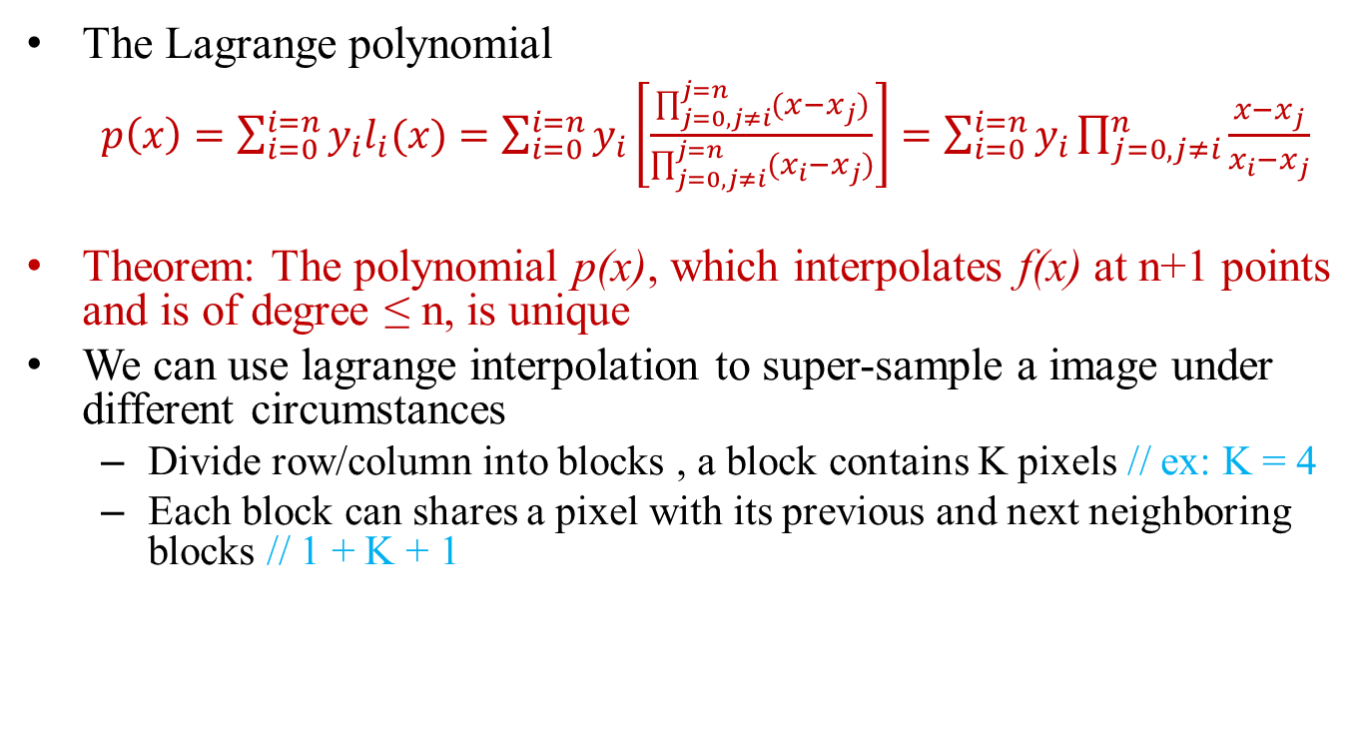
Lagrange interpolation
The Lagrange polynomial
$p\left(x\right)=\sum_{i=0}^{i=n}{y_{i}l_{i}(x)}=\sum_{i=0}^{i=n}{y_{i}\left[\frac{\prod_{j=0,j≠i}^{j=n}{(x−x_{j})}}{\prod_{j=0,j≠i}^{j=n}{(x_{i}−x_{j})}}\right]}=\sum_{i=0}^{i=n}{y_{i}\prod_{j=0,j≠i}^{n}{\frac{x−x_{j}}{x_{i}−x_{j}}}}$
Theorem: The polynomial p(x), which interpolates f(x) at n+1 points and is of degree ≤ n, is unique
We can use lagrange interpolation to super-sample a image under different circumstances
Divide row/column into blocks , a block contains K pixels // ex: K = 4
Each block can shares a pixel with its previous and next neighboring blocks // 1 + K + 1

Slide 17


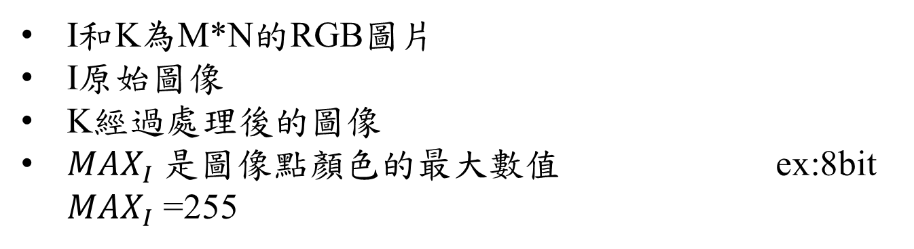
PSNR
I和K為M*N的RGB圖片
I原始圖像
K經過處理後的圖像
${MAX}_{I}$ 是圖像點顏色的最大數值 ex:8bit ${MAX}_{I}$ =255

Slide 18
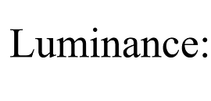
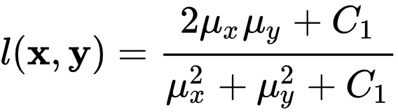
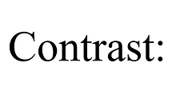
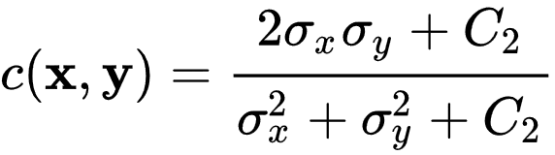
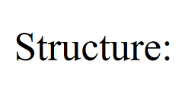
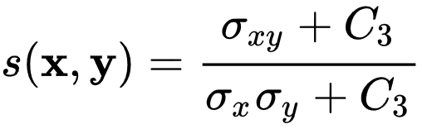
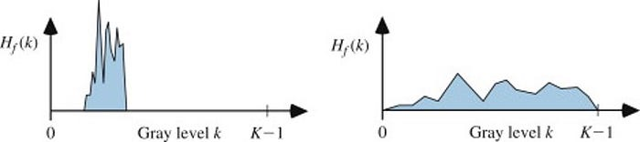
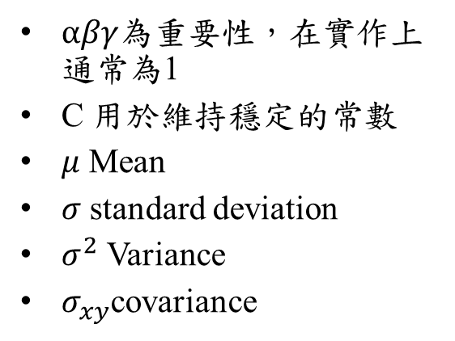
SSIM
$αβγ$為重要性，在實作上通常為1
C 用於維持穩定的常數
$μ$ Mean
$σ$ standard deviation
$σ^{2}$ Variance
$σ_{xy}$covariance

Slide 19

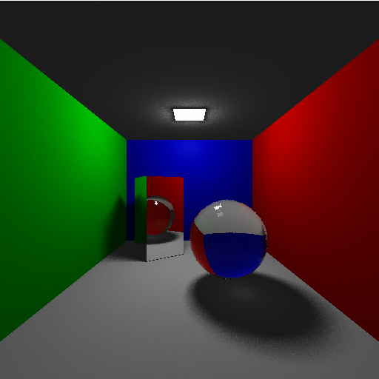
Original RGB image
Resolution:64x64
Resolution:512x512

Slide 20
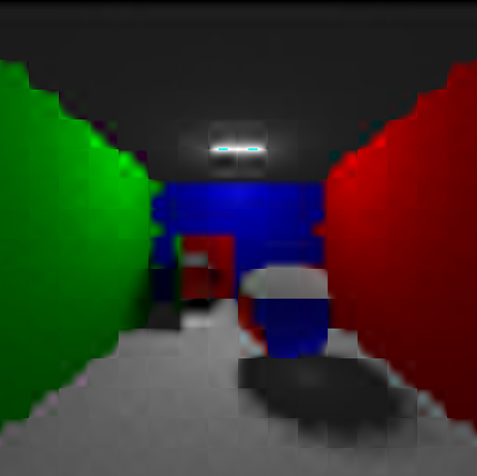



Result
Lagrange interpolation with block size = 4
K
1 + K + 1

Slide 21
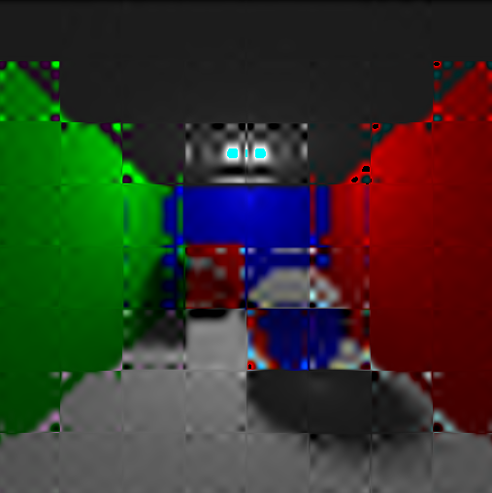
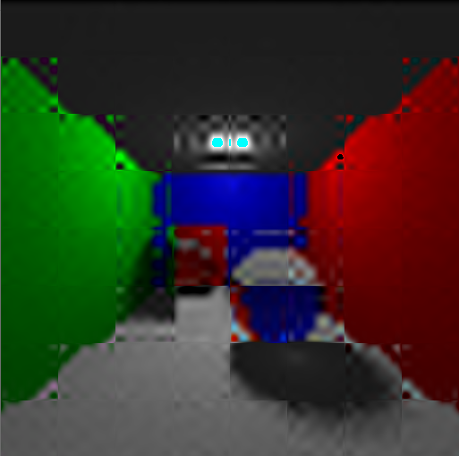


Result
Lagrange interpolation with block size = 8
K
1 + K + 1

Slide 22




Result
Lagrange interpolation with block size = 16
K
1 + K + 1

Slide 23
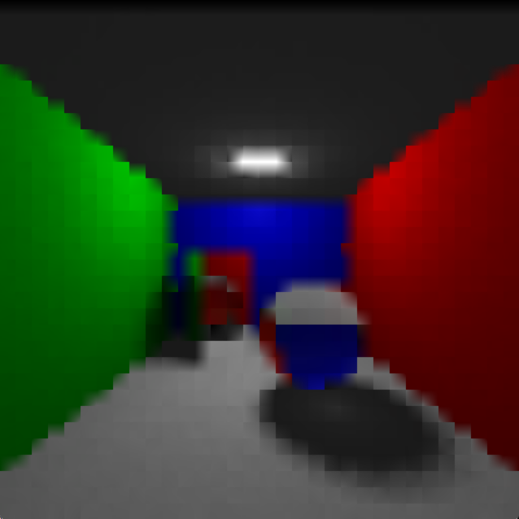
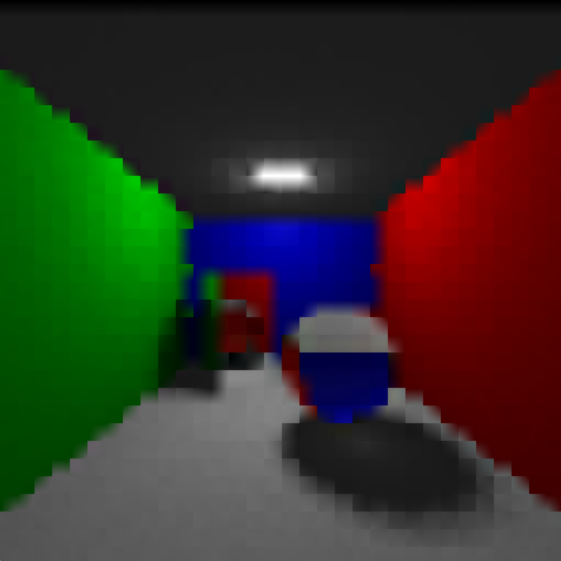


Result
Lagrange interpolation with block size = 2
K
1 + K + 1

Slide 24



Analysis
Lagrange interpolation
K | 2 | 4 | 8 | 16
PSNR | 25.60 | 25.37 | 22.78 | 11.50
SSIM | 0.924995 | 0.923335 | 0.874765 | 0.402125
1+K+1 | 2 | 4 | 8 | 16
PSNR | 25.46 | 25.46 | 23.93 | 13.24
SSIM | 0.923615 | 0.924440 | 0.901377 | 0.501433

Slide 25
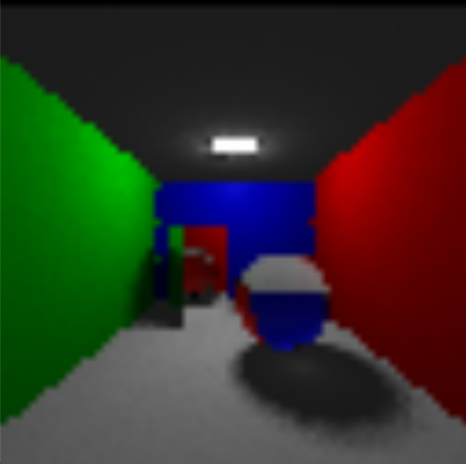

Result
Bilinear interpolation(2by2)
Origin
Linear

Slide 26


Result
Bicubic spline interpolation(4by4)
Origin
Cubic spline

Slide 27


Result
Bicubic spline interpolation(whole row/column)
Origin
Cubic spline

Slide 28
Analysis
K | Bilinear | Bicubic(4) | Bicubic(all line)
PSNR | 25.79 | 25.29 | 24.67
SSIM | 0.929455 | 0.923665 | 0.907625
Linear
Cubic spline

Slide 29
Outline
Introduction
Interpolation
Linear
Cubic
Lagrange
Result and analysis
EDSR

Slide 30
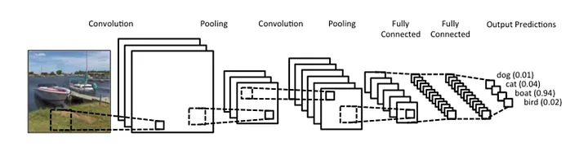
AI approaches
Convolutional Neural Networks(CNN)
是最早被用於Super Resolution的AI方法之一
利用捲積學習圖像特徵，學習用低解析度圖片重建高解析度圖片

Slide 31
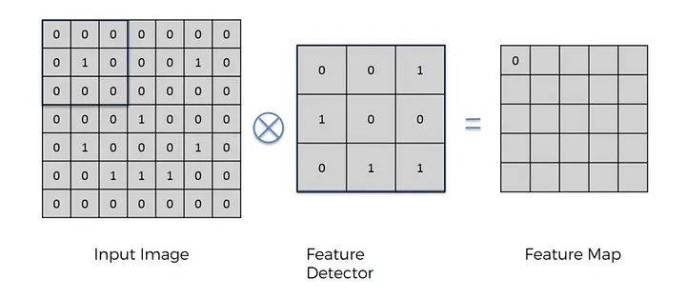
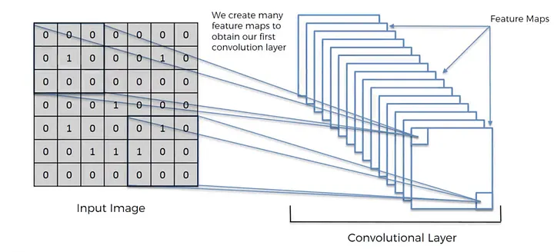
AI approaches
Convolutional Neural Networks(CNN)
Convolution Layer

Slide 32
AI approach paper
Enhanced Deep Residual Networks for Single Image Super-Resolution
利用cnn加上最佳化過的殘差網路來做super resolution
提供了兩個模型，一個單尺度的EDSR和一個多尺度的MDSR
主要貢獻是對於ResNet 架構的更改使其更適合super resolution

Slide 33
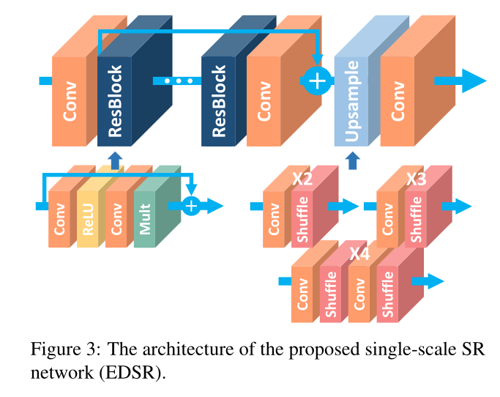
EDSR
淺層特徵提取
ResBlock
上採樣模組
Sub-pixel Convolution
利用L1 loss function
Mean Absolute Error

Slide 34
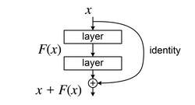
Residual Neural Network(ResNet)
目的
減輕深層網路訓練的難度
解決梯度消失和梯度爆炸
Residual Block
利用Shortcut Connection把原始輸入和輸出相加
學習輸入和輸出之間的殘差映射，而不是直接學習輸出

Slide 35
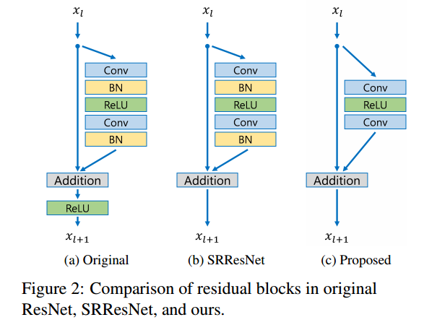
Residual Neural Network(ResNet)
EDSR做出的改進
刪除Batch Normalization
BN會限制特徵值的範圍，在
super resolutrion的工作中可能會
限制模型的表現
加上residual scaling

Slide 36
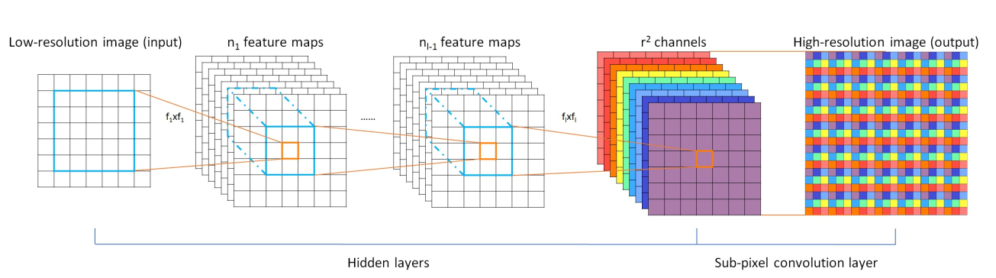
Upsample
sub-pixel convolution
透過重新排列pixel來獲得高解析度圖片

Slide 37

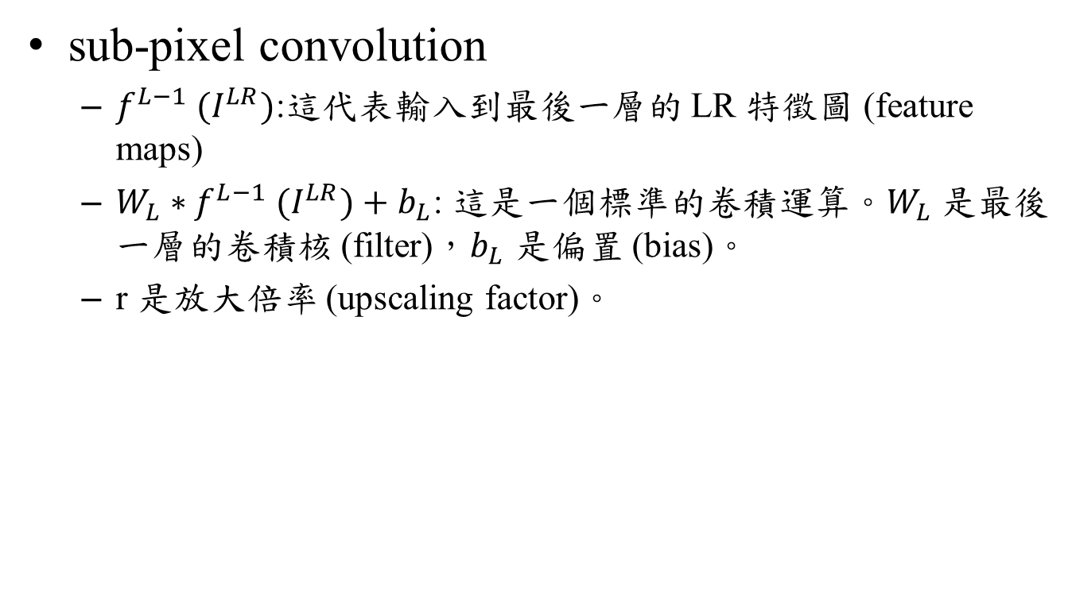
Upsample
sub-pixel convolution
$f^{L−1} (I^{LR})$:這代表輸入到最後一層的 LR 特徵圖 (feature maps)
$W_{L}​∗f^{L−1} (I^{LR})+b_{L}$​: 這是一個標準的卷積運算。$W_{L}$​ 是最後一層的卷積核 (filter)，$b_{L}$​ 是偏置 (bias)。
r 是放大倍率 (upscaling factor)。

Slide 38
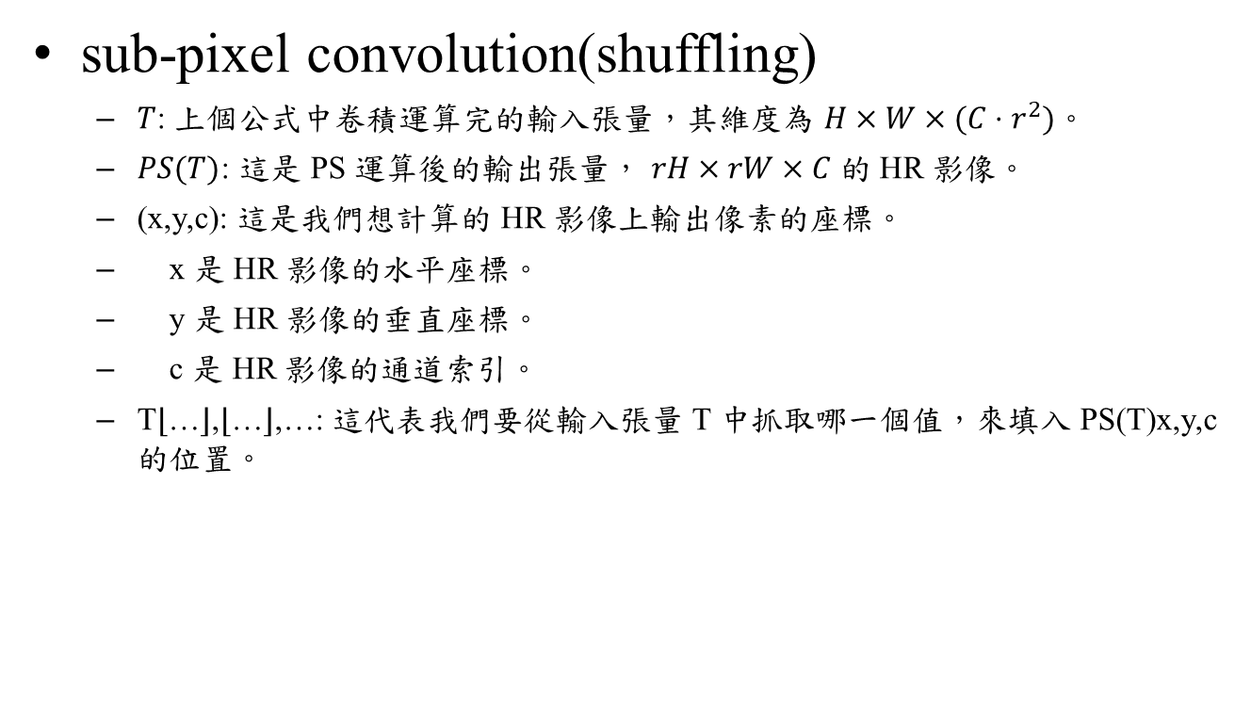
Upsample
sub-pixel convolution(shuffling)
$T$: 上個公式中卷積運算完的輸入張量，其維度為 $H×W×(C⋅r^{2})$。
$PS(T)$: 這是 PS 運算後的輸出張量， $rH×rW×C$的 HR 影像。
(x,y,c): 這是我們想計算的 HR 影像上輸出像素的座標。
x 是 HR 影像的水平座標。
y 是 HR 影像的垂直座標。
c 是 HR 影像的通道索引。
T⌊…⌋,⌊…⌋,…​: 這代表我們要從輸入張量 T 中抓取哪一個值，來填入 PS(T)x,y,c​ 的位置。

Slide 39

Loss function
L1 Loss Function(MAE) is used to minimize the error which is the sum of the all the absolute differences between the true value and the predicted value.

Slide 40
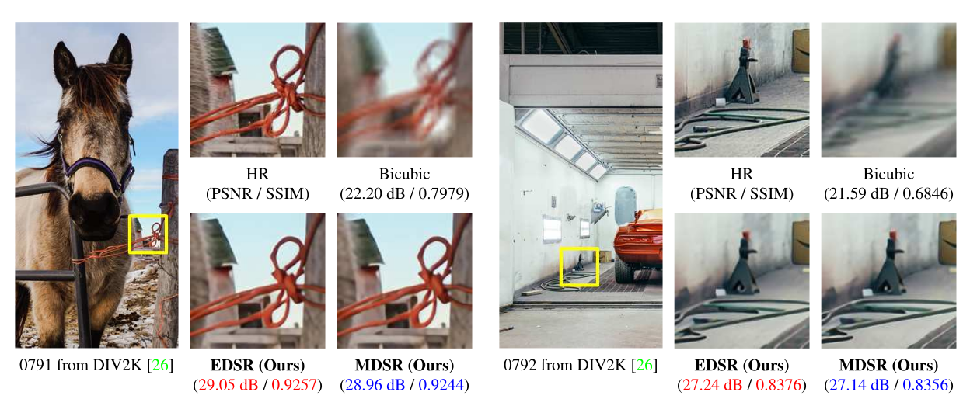
Evaluation

Slide 41
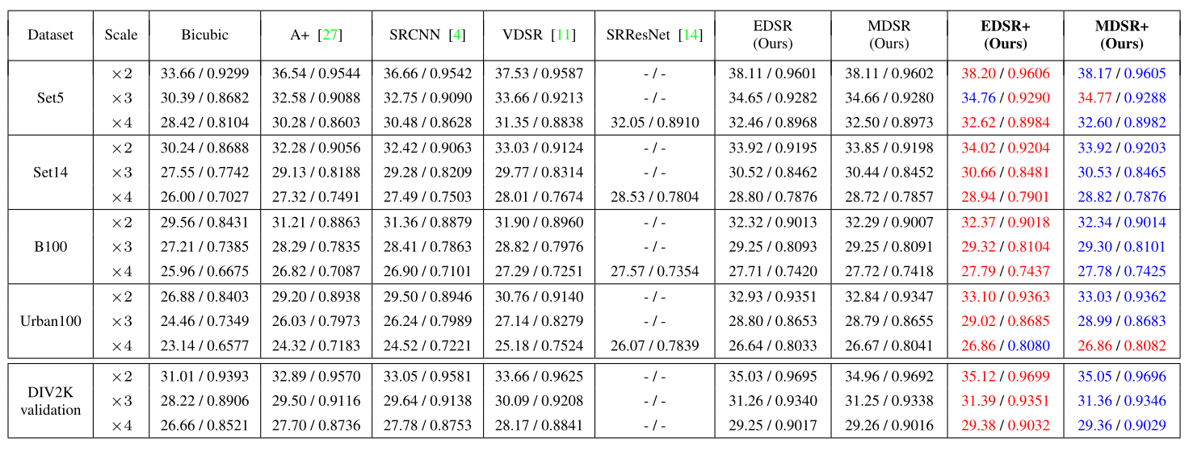
Evaluation

Slide 42
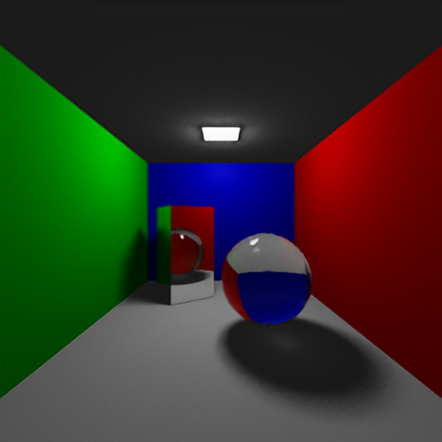
Test
Epoch = 300
Batch size=4
Kernel size=3*3
ResBlocks = 16
Features = 64
Scale = 4
res_scale =1.0
Loss Function=L1
Optimizer = Adam
512*512
ground truth EDSR x4

